Slide 1
Insular Areas and Alaska Native-Serving and Native Hawaiian-Serving Institutions Competitive Grants Programs
Kellyann Jones-Jamtgaard, PhD

Slide 2
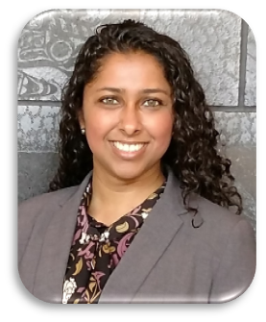
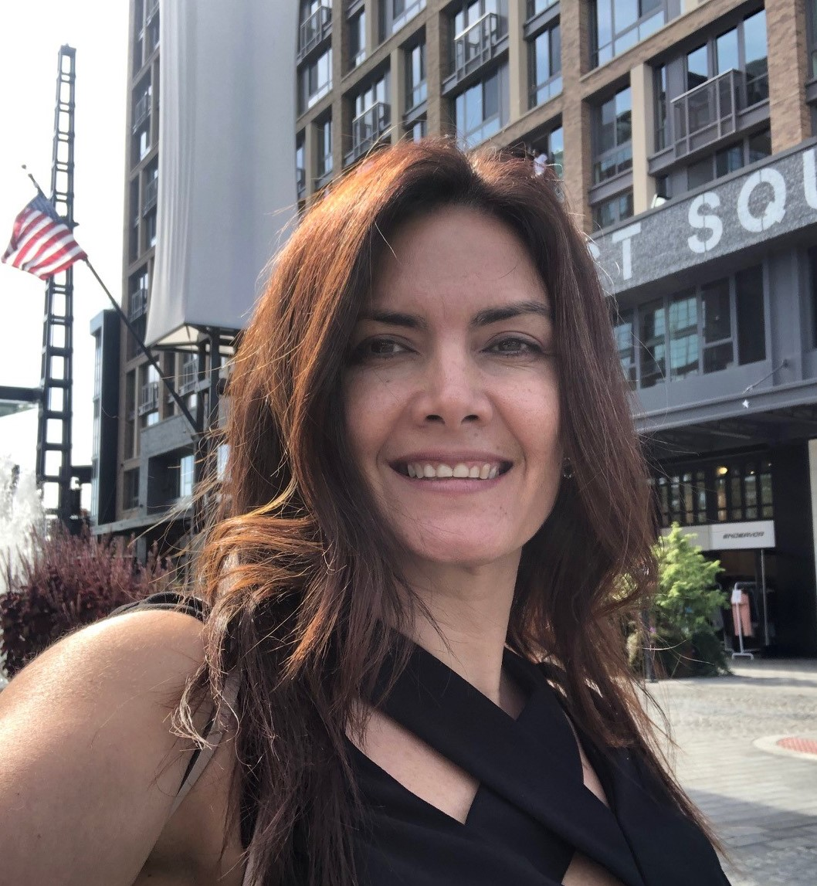
Program Staff
Kellyann Jones-Jamtgaard, PhD
National Program Leader
kellyann.jonesjamtgaard@usda.gov
Dorissel Resto, M.S.
Program Specialist
Dorissel.Resto@usda.gov
Notes:
Add Irma’s cell phone

Slide 3
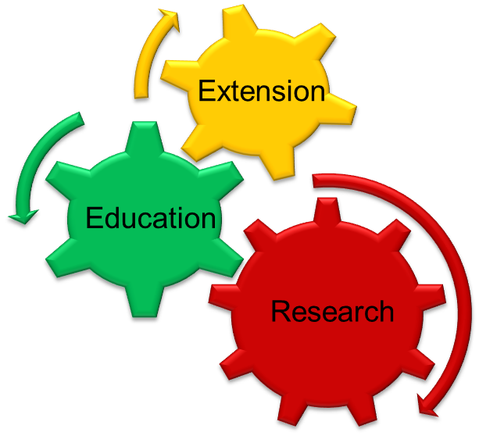
NIFA’s Mission
To invest in and advance agricultural research, education and extension to solve societal challenges.
NIFA provides:
Capacity grants to land-grant universities​
Competitive grants to support research, education and extension at various institutions​ including:
Land-grant universities, non-land-grants, minority-serving institutions, community colleges, and other organizations​
A

Slide 4
Topics Covered by NIFA Programs
Advanced Technologies
Bioenergy; Biotechnology; Nanotechnology
Animals
Animal Breeding; Animal Health; Animal Production; Aquaculture
Business and Economy
Markets and Trade; Natural Resource Economics; Small Business
Natural Resources
Forests; Grassland and Rangeland; Soil, Water, and Air
Education
Minority Serving Institutions; Teaching and Learning; Workforce Development
Environment
Climate Change; Ecosystems; Invasive Pests and Diseases
Farming and Ranching
Agriculture Safety & Technology; Farmer Education; Organic & Family Farms
Human Sciences
Community Vitality; Family Well-Being; Youth
Food Science
Food Quality; Food Safety
Food and Nutrition Security
Nutrition; Obesity; Wellness
International
Global Engagement; Global Food Security
Plants
Crop Production; Pest Management; Plant Breeding; Plant Health

Slide 5
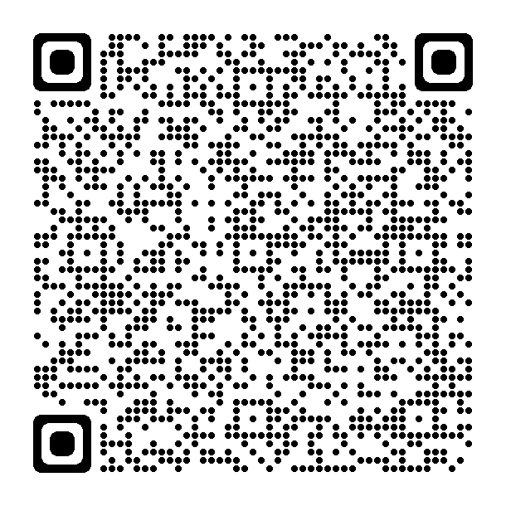
NIFA Competitive Programs for the Insular Areas
1. Distance Education Grants (DEG) Program for Institutions of Higher Education in Insular Areas
2. Resident Instruction Grants Program for Institutions of Higher Education in Insular Areas (RIIA)
Eligibility: Public or non-profit 2-year and 4-year accredited institutions of higher education that offer certificate/degree programs in the agricultural sciences in an Insular Area.
Type of Grant: Teaching and Education
3. Agriculture and Food Sciences Facilities and Equipment (AGFEI)
Eligibility: individual land-grant colleges and universities, and other institutions that have secured land-grant status through Federal legislation, and which are located at Insular Areas
Type of Grant: Facilities and Equipment
D
Notes:
Insular areas: American Samoa, Federated States of Micronesia, Guam, Northern Mariana Islands, Republic of Palau, Republic of the Marshall Islands, Puerto Rico and, Virgin Islands of the United States.

Slide 6
NIFA Competitive Programs for the Insular Areas..
Since 2005, NIFA has funded 63 grants for a total amount of $12.5 million in the Pacific Area
FY 2024 Anticipated total funding available: $2.3 million
FY 2024 RIIA/AGFEI application deadline is February 28, 2024
FY 2024 DEG application deadline is March 20, 2024
D
Notes:
Insular areas: American Samoa, Federated States of Micronesia, Guam, Northern Mariana Islands, Republic of Palau, Republic of the Marshall Islands, Puerto Rico and, Virgin Islands of the United States.

Slide 7
Title: Development of Online Courses in Tropical Wildlife Management
Institution: University of Guam
Distance Education Grants
Purpose is to strengthen the capacity of institutions to carry out programs in the food and agricultural sciences through distance education technology.
Grantees can use funds to:
Acquire equipment, networking capability, hardware/software, and infrastructure to support distance education
Curriculum development and enhancing educational services
Provide professional development for educators in using technology in the classroom
D

Slide 8
Title: Building student and professional capacity in Agricultural and Natural Resources Management Fields through GIS and Remote Sensing Coursework
Institution: Northern Marianas College
Resident Instruction Grants for Institutions of Higher Education in Insular Areas
Purpose is to promote and strengthen the ability of eligible institutions in the Insular Areas to carry out education within the food and agricultural sciences.
Grantees can use funds for:
Recruit and retain undergraduate and graduate students to need areas in food and agricultural sciences, including scholarships
Experiential learning opportunities
Curriculum development, scientific instrumentation for teaching, improving library capacity
Professional development for faculty
Some funded topics are sustainable small farms, geographic information systems, genomics and bioinformatics, nutrition, and medicinal plants
D

Slide 9
Agriculture and Food Sciences Facilities and Equipment
Purpose is to support activities to acquire, alter or renovate facilities or relevant equipment necessary for conducting agricultural research.
Grantees can use funds for:
acquisition, repair and remodeling of facilities, laboratories, and other capital facilities (including fixtures and equipment)
Emphasis on tropical and subtropical agricultural research, including pest and disease research.
Some funded topics are improving energy resilience, acquiring equipment,and remodeling greenhouses
D

Slide 10
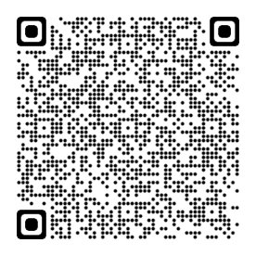
Alaska Native-Serving and Native Hawaiian-Serving Education Grants Program (ANNH)
Eligibility: Individual public or private, nonprofit Alaska Native-Serving and Native Hawaiian-Serving Institutions of higher education
Alaska Native-Serving: undergraduate enrollment of at least 20% Alaska Native students
Native Hawaiian-Serving: undergraduate enrollment of at least 10% Native Hawaiian students
Type of Grants: Education Projects, Extension Projects, Applied Research Projects, or Integrated Research, Extension and Education Projects
Since 2001, NIFA has funded 89 grants for a total amount of $73 million.
FY 2024 ANNH application deadline is March 5, 2024 for $6.3 million
D
Notes:
Insular areas: American Samoa, Federated States of Micronesia, Guam, Northern Mariana Islands, Republic of Palau, Republic of the Marshall Islands, Puerto Rico and, Virgin Islands of the United States.

Slide 11
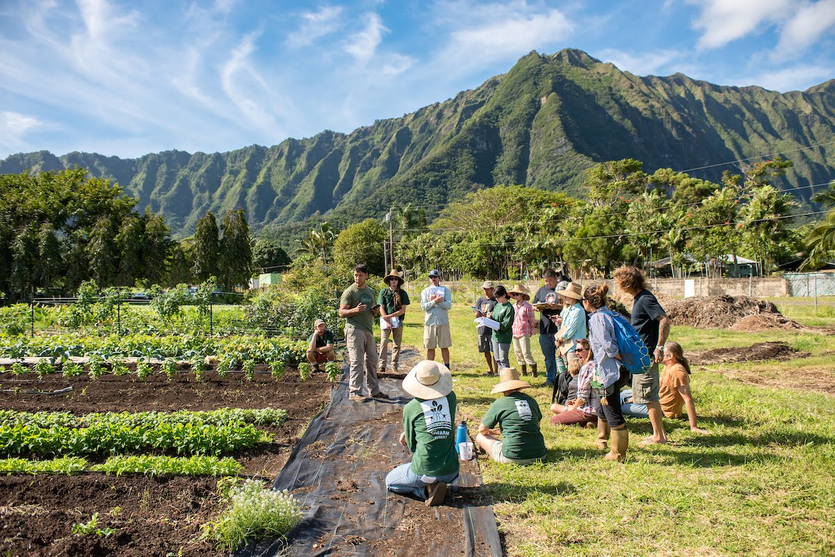
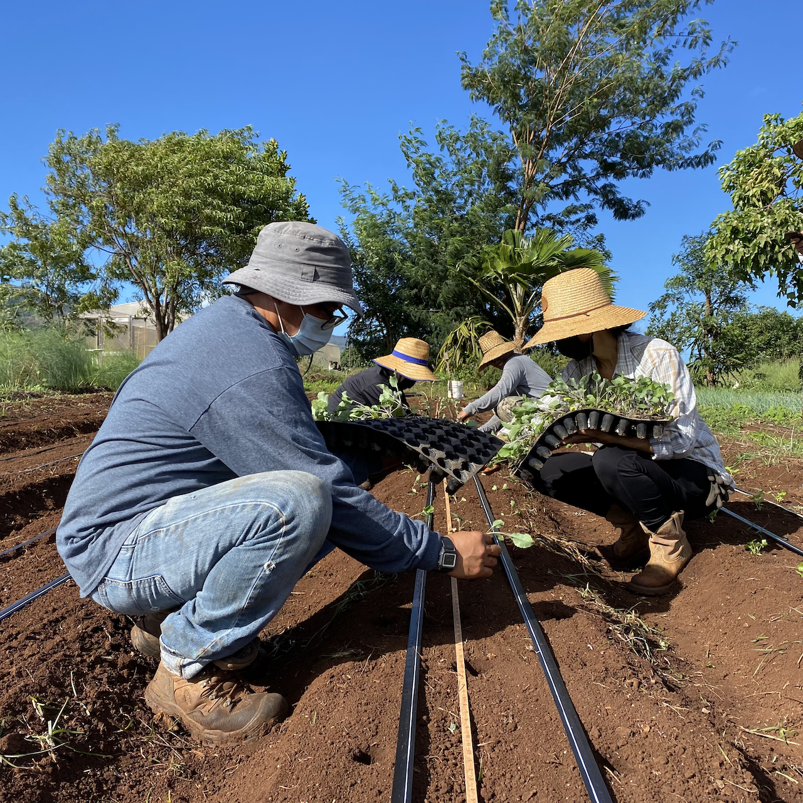
Purpose and Priorities
To promote and strengthen the ability of ANNH-Serving Institutions to carry out education, applied research, and related community development programs.
Grantees can use funds for:
Recruit and retain undergraduate and graduate students to need areas in food and agricultural sciences, including scholarships
Experiential learning opportunities
Curriculum development, scientific instrumentation for teaching, improving library capacity
Professional development for faculty
Support informal education to increase agricultural and food literacy amongst youth and adults
Implementing practical ways for the dissemination of fundamental knowledge to communities
Title: GoFarm Hawai'i (GFH): Training New Farmers and Growing Agribusiness in Hawai'i
Institution: University of Hawai'i
https://vimeo.com/642030435
D

Slide 12
NIFA encourages applications from the Insular Areas and ANNH programs to include, as applicable:
Global Engagement
Leadership Skills Development
Incorporation of Social Sciences and Enhancing Impacts
Traditional Ecological Knowledge and Native Language Preservation
D

Slide 13
NextGen program
Historic $250 million investment in Minority-Serving Institutions with awards made in summer 2023
Funded activities are scholarship projects, experiential learning projects, and/or outreach and engagement projects
Awards made to Native Hawaiian-Serving Institutions and Insular Areas Institutions located in the Pacific:
University of Hawaii at Manoa, “Cultivating the NextGen of Diverse Biosecurity Professionals Through a Pacific-Continental Network”
University of Guam, “Creation of a Cooperative BS Degree Program For the Marianas Islands and Beyond”
Northern Marianas College, “Agritourism: Regenerative Workforce Initiative for African American and Insular Communities”
D
Notes:
Insular areas: American Samoa, Federated States of Micronesia, Guam, Northern Mariana Islands, Republic of Palau, Republic of the Marshall Islands, Puerto Rico and, Virgin Islands of the United States.

